Slide 1
Reaction Simulator:
A BIOEN 437 project
By: Matthew Van Ginneken & Olivia Walsh

Slide 2
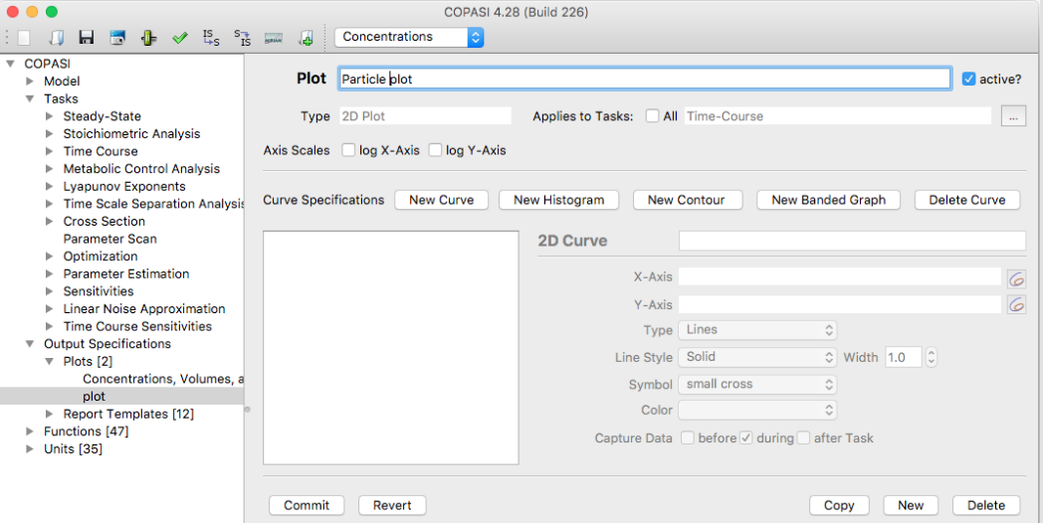
Background
Create a web based app to visualize reaction kinetics
Easy to use for beginners
Accessible
Simple
Similar Packages
COPASI
JigCell
Figure 1: A clip of COPASI graph creator
Notes:
Olivia

Slide 3
Use Cases
The user can iteratively submit reactions and constants and then view the steady state graph
The user can submit an antimony txt file and then view the steady state graph and steady state values
The user can submit an SBML file and then view the steady state graph and steady state values
Notes:
Matthew

Slide 4
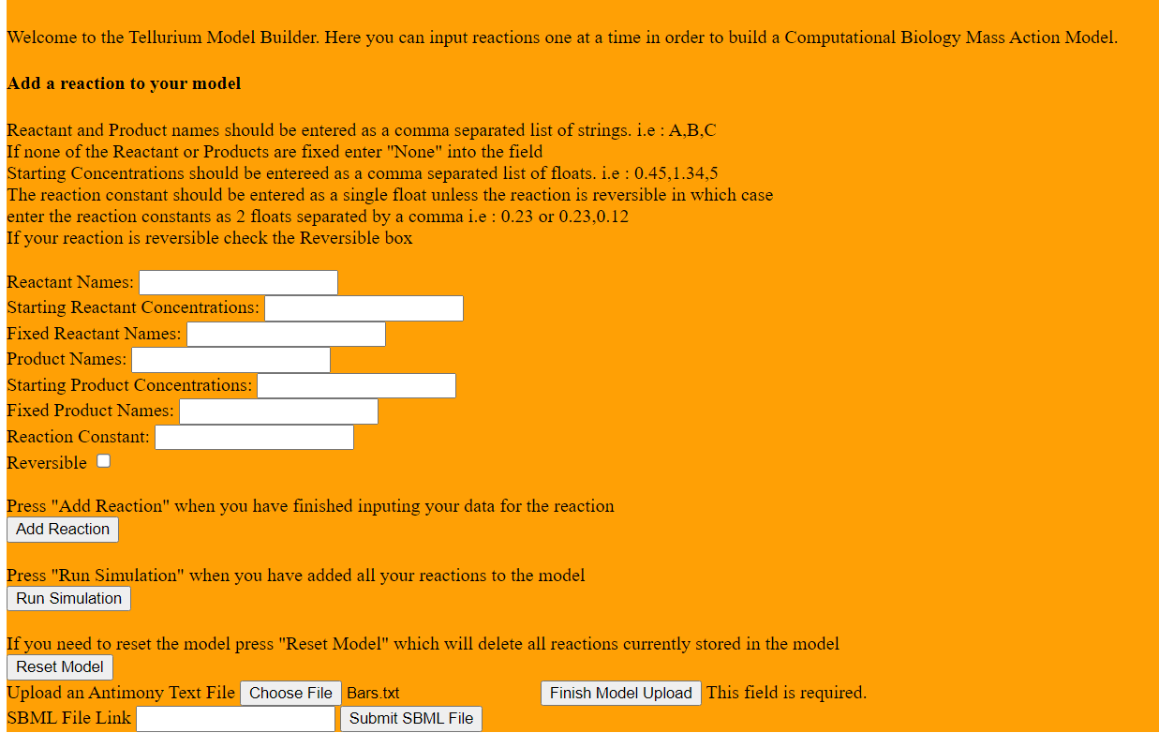
Demo
Notes:
Video? Or matthew

Slide 5
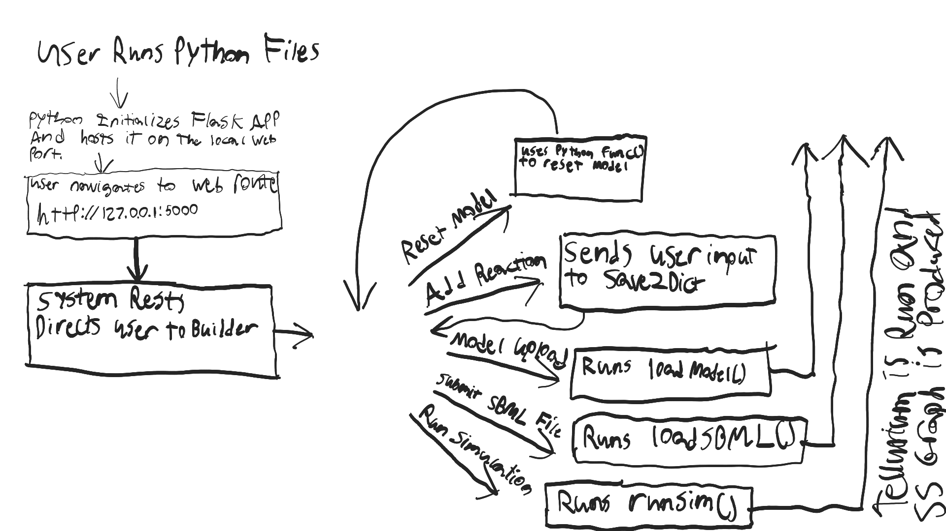
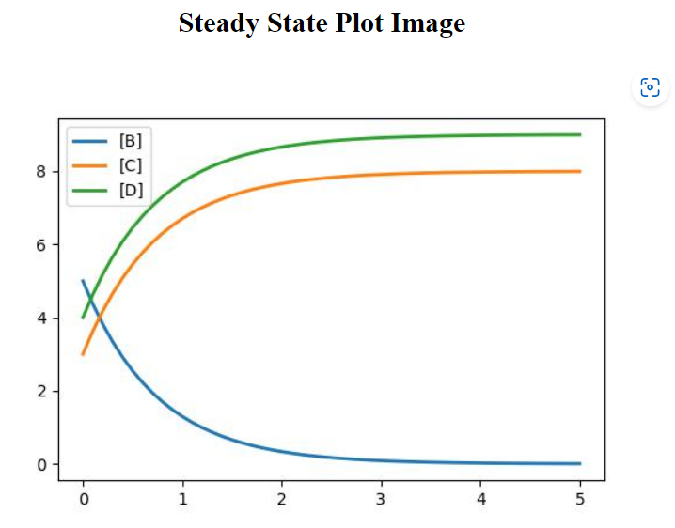
Design - Flask Webpage

Slide 6
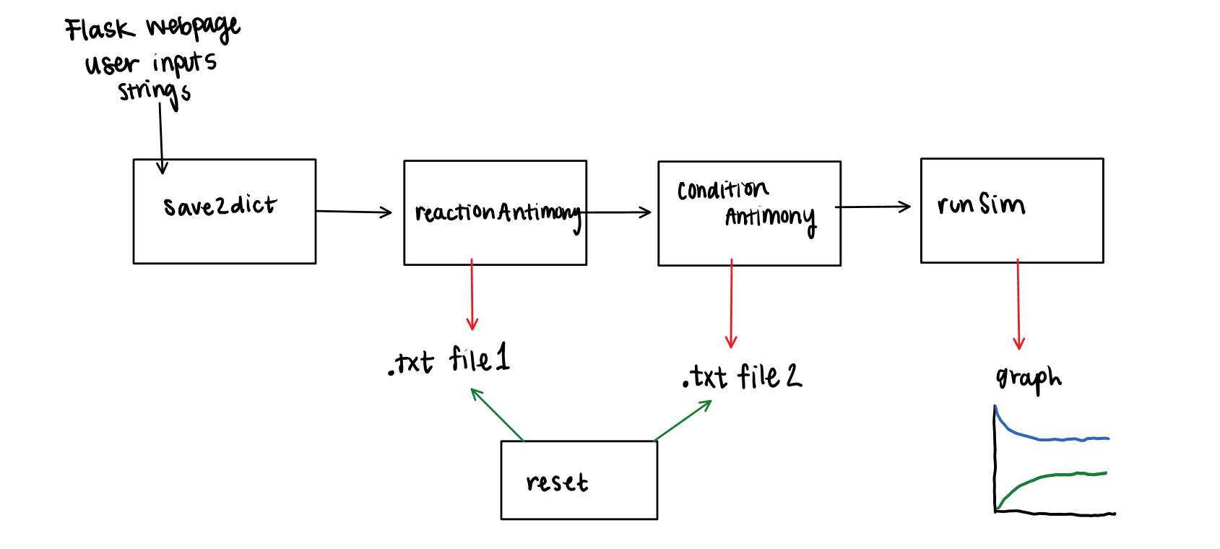
Design - Running the Simulations Through Python
Notes:
Olivia

Slide 7
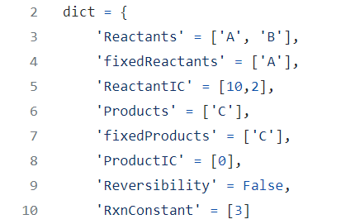


Design - Python Functions
Save2dict
Antimony Builder
2 separate functions, iteratively add to two separate txt files
runSim
JPG file of the graph
Notes:
Olivia

Slide 8
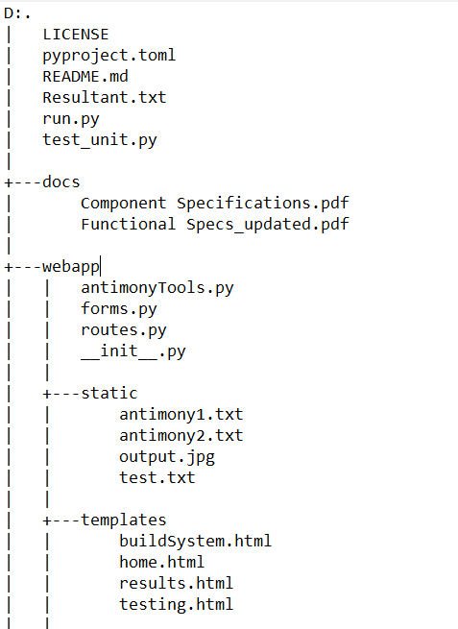
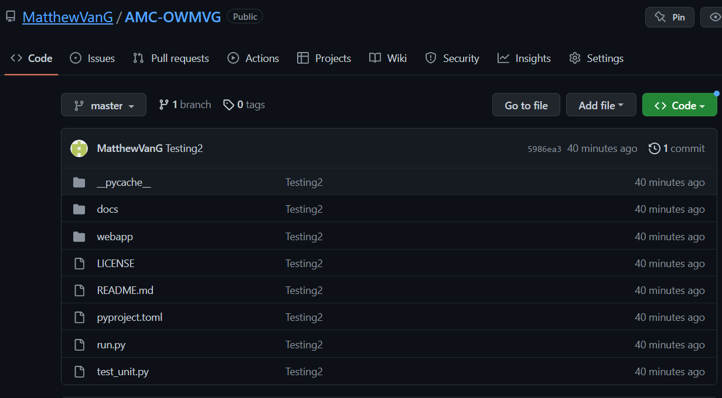
Project Structure
https://github.com/MatthewVanG/AMC-OWMVG
Notes:
Matthew

Slide 9
Lessons Learned
Working on different parts of the code then combining
Creating tests using Python’s unittest
Documentation and process of creating working code and submitting as a python package
Notes:
Olivia

Slide 10
Future Directions
Adding in other functions from tellurium
Showing different features of the simulation such as steady state values and system fluxes
User can import an antimony txt file and then add to it with our webpage
Being able to remove a reaction after it has been submitted
Notes:
Matthew

Slide 11
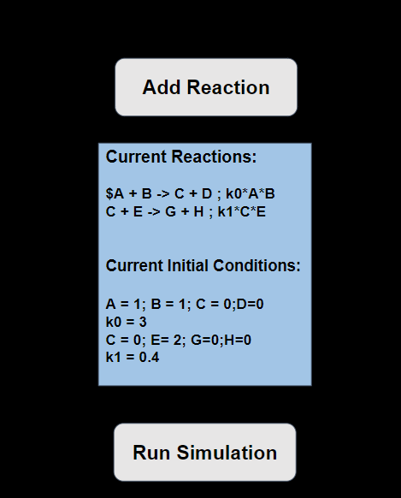
Future Directions
Listing the reactions that are submitted
Help the user with organization
User can check if the reaction was inputted correctly
Notes:
Olivia

Slide 12
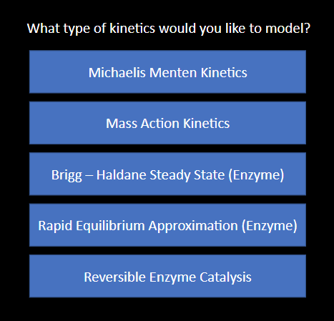
Future Directions
Allowing the user to simulate more than one type of reaction kinetics
Implemented with options given in a home page
Notes:
Matthew

